Slide 1

The Impact of Climate Change
Threat of mass destruction from rising sea levels
By: Kashyap Bagare, Dylan McCullor, Uma Sivakumar, Richard Ybarra
Notes:
Richard begins presentation.

Slide 2
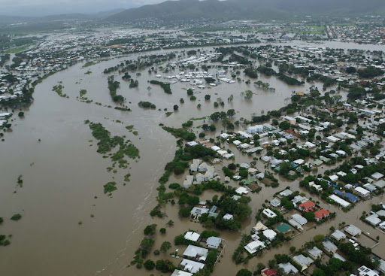
Introduction
The Team
Kashyap Bagare - Data manipulator extraordinaire
Dylan McCullor - Cartography king
Uma Sivakumar - Lead Skynet programmer
Richard Ybarra - Editor in chief
Climate Change
Melting sea ice
Rising sea levels
Notes:
In alphabetical order, our team consisted of Kashyap who was responsible for creating our database and cleaning data. Dylan created complex map visualizations to display the real world impact of rising sea levels. Uma handled our machine learning models and tableau visualizations. Richard was in charge of Github, code review, and storytelling.

Slide 3

Purpose
To gather sea level and sea ice data for the purpose of determining the sea level at the point that sea ice extent reaches zero.
To visualize the impact of rising sea level.
Notes:
Richard explains purpose then passes to Kashyap

Slide 4
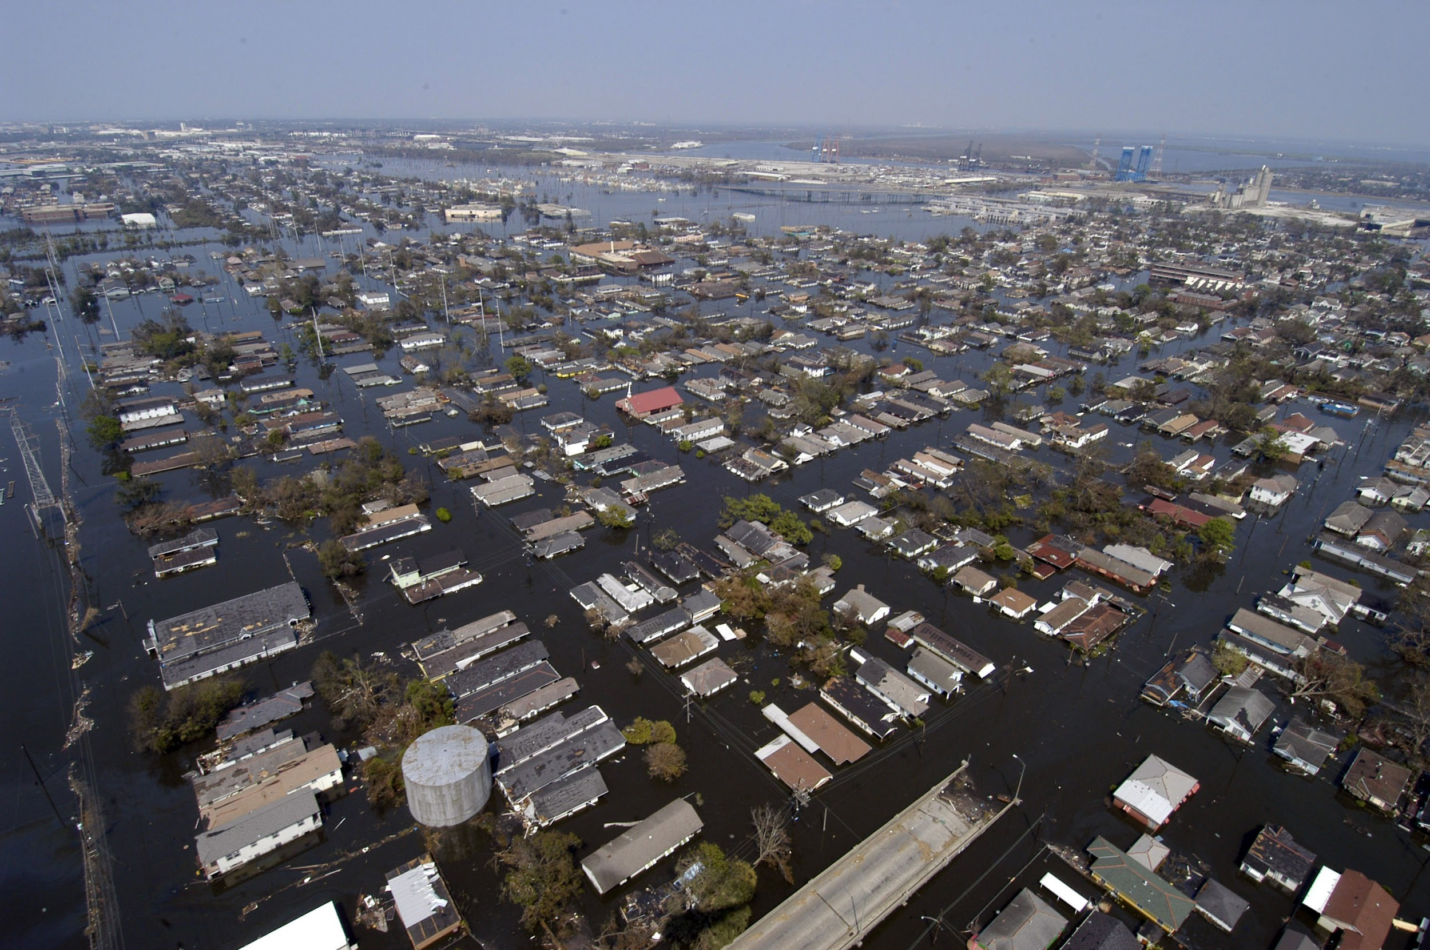
Data Collection
Kaggle
Global Sea Level Data
Sea Ice Extent Data
Global Sea Level
Total Weighted Observations
Global Mean Sea Level (Glacial Isostatic Adjustment)
Sea Ice Extent
Hemisphere
Extent
Notes:
Used Kaggle in order to find two datasets (the Global Sea Level Data and the Sea Ice Extent Data)
For the Global Sea Level Data, the two relevant columns we were interested in were the TWO, and the GMSL_GIA
The Global Isostatic Adjustment is a way to adjust the GMSL based on geophysical phenomena leading to the movement of land/continental ice sheets (chose this one because we felt it was more accurate)
For the Sea Ice Extent, the two relevant columns we were interested in were the Hemisphere and Extent columns
Looking at northern hemisphere specifically because southern hemisphere had really consistent data and 75% of the world’s population is in the northern hemisphere.
Ice extent is the area covered by some amount of ice

Slide 5
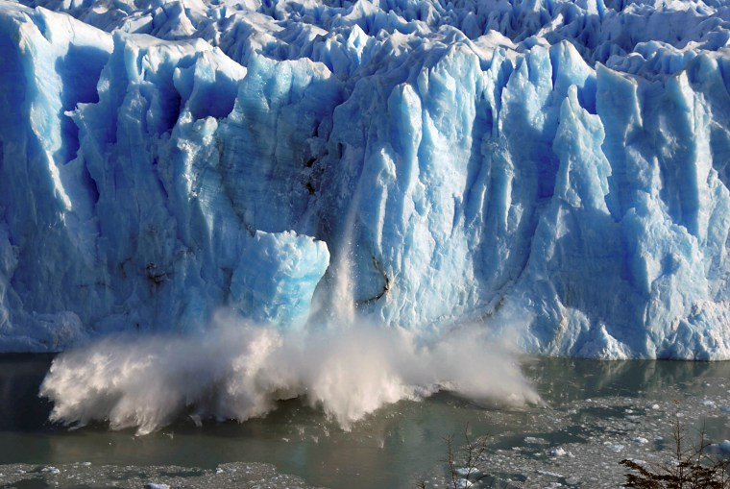
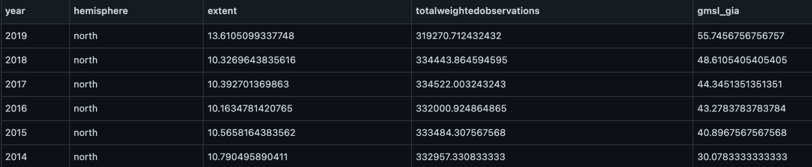
Database Structure and Cleaning
PostGreSQL
Merged on Year column
Averaged extent and gmsl_gia data
Notes:
We used PostGreSQL because it was the most straightforward way to get a database with the relevant information we wanted
We merged both the previous databases on the Year column
This was a problem as there were multiple entries for each year and one database started in 1978 while another started at 1993
In order to get around this, we averaged the relevant values for the year so we had one entry per year and only merged on years that had gmsl_gia AND extent data

Slide 6
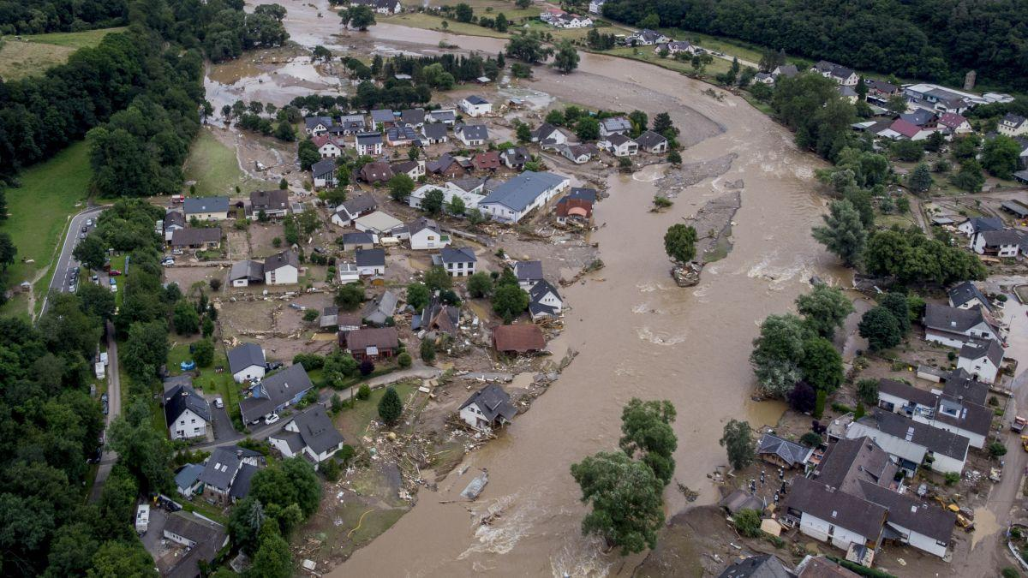
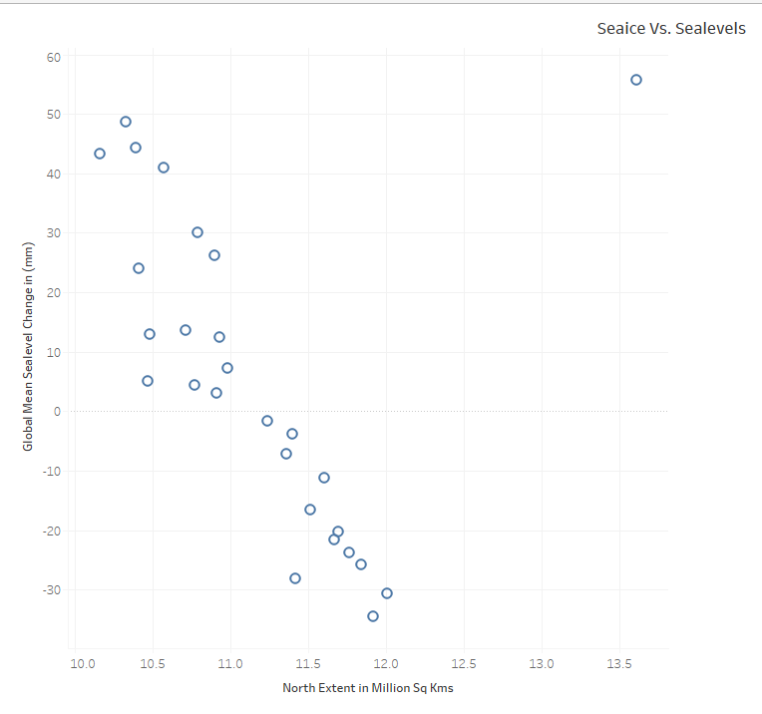
Machine Learning Structure
Scatter plot indicated a linear relationship between north_extent and gmsl_gia
We had two main variables only hence we chose a simple linear regression model
An outlier in the data was meddling with our model results and needed to be taken care of
We created two models
One using R
Another using Python
Notes:
Uma explains our learning model and why we chose it.

Slide 7
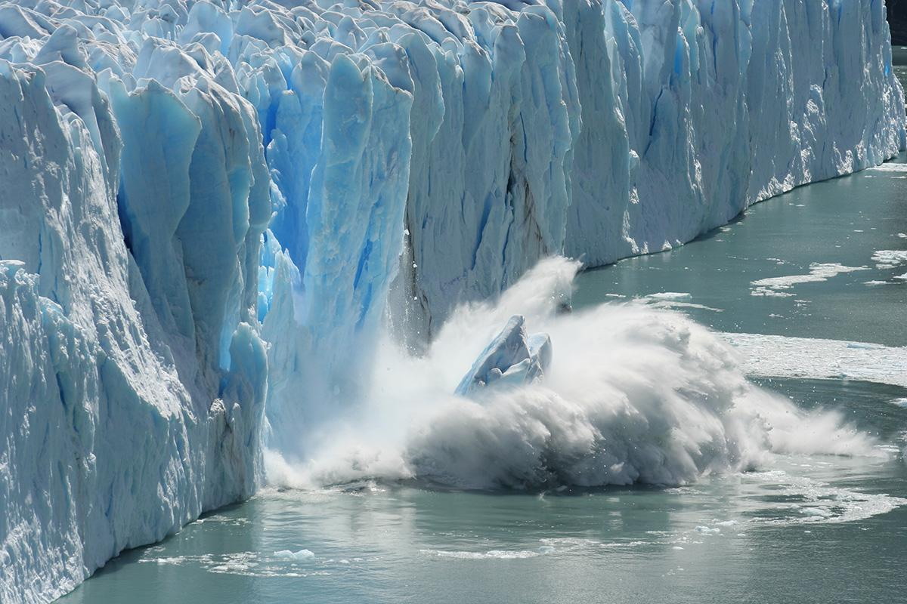
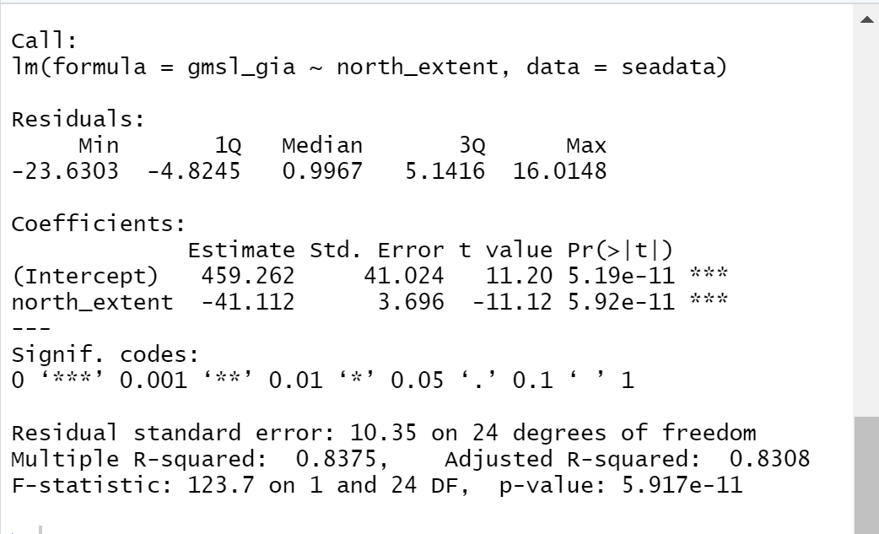
Machine Learning Results
The Intercept is 459.262
The P value is < .0001 which is much less than 0.05 hence we reject our null hypothesis
A coefficient of -41.112 is indicates the direction of the relationship between variables. In our case it is negative
R-Squared - 0.8375 indicates that our model is a good fit
F-Statistic - 123.7 is far greater than 1 so we can say that there is a relationship between predictor and response variable
Notes:
Intercept is y-value when the x-value is 0 - This means that when seaice(X) becomes zero - sea levels (y) will rise by 459.262 mm, 18 inches or .46 meters on an average - The dramatic impacts of this will be explained by Dylan in the coming slides
The lesser the ‘p’ value the more significant is the variable.
coefficients are the values that multiply the predictor values. ... The sign of each coefficient indicates the direction of the relationship between a predictor variable and the response variable. A positive sign indicates that as the predictor variable increases, the response variable also increases.
R squared value indicates how much variation is captured by the model. R2 closer to 1 indicates that the model explains the large value of the variance of the model and hence a good fit
We can answer this using F stats. This defines the collective effect of all predictor variables on the response variable. In this model, F=123.7 is far greater than 1, and so it can be concluded that there is a relationship between predictor and response variable.

Slide 8
Mapping it out
Maps were created using the Mapbox API, NOAA’s Vdatum API and Pillow Image library
Our linear regression Model determined that the sea level at the point of 0 Arctic sea ice would be about 0.4 meters above what it is today
Areas below this new sea level were mapped in red.
Using the high tide of each area, we were able to determine flood risk zones, which are mapped in orange
Notes:
National Oceanic and Atmospheric Administration. Mapped 5 of the most at-risk cities on the US east coast. Many other factors will contribute such as temperature of water causing expansion/access to waterways determining flood zones. Rough model.

Slide 9
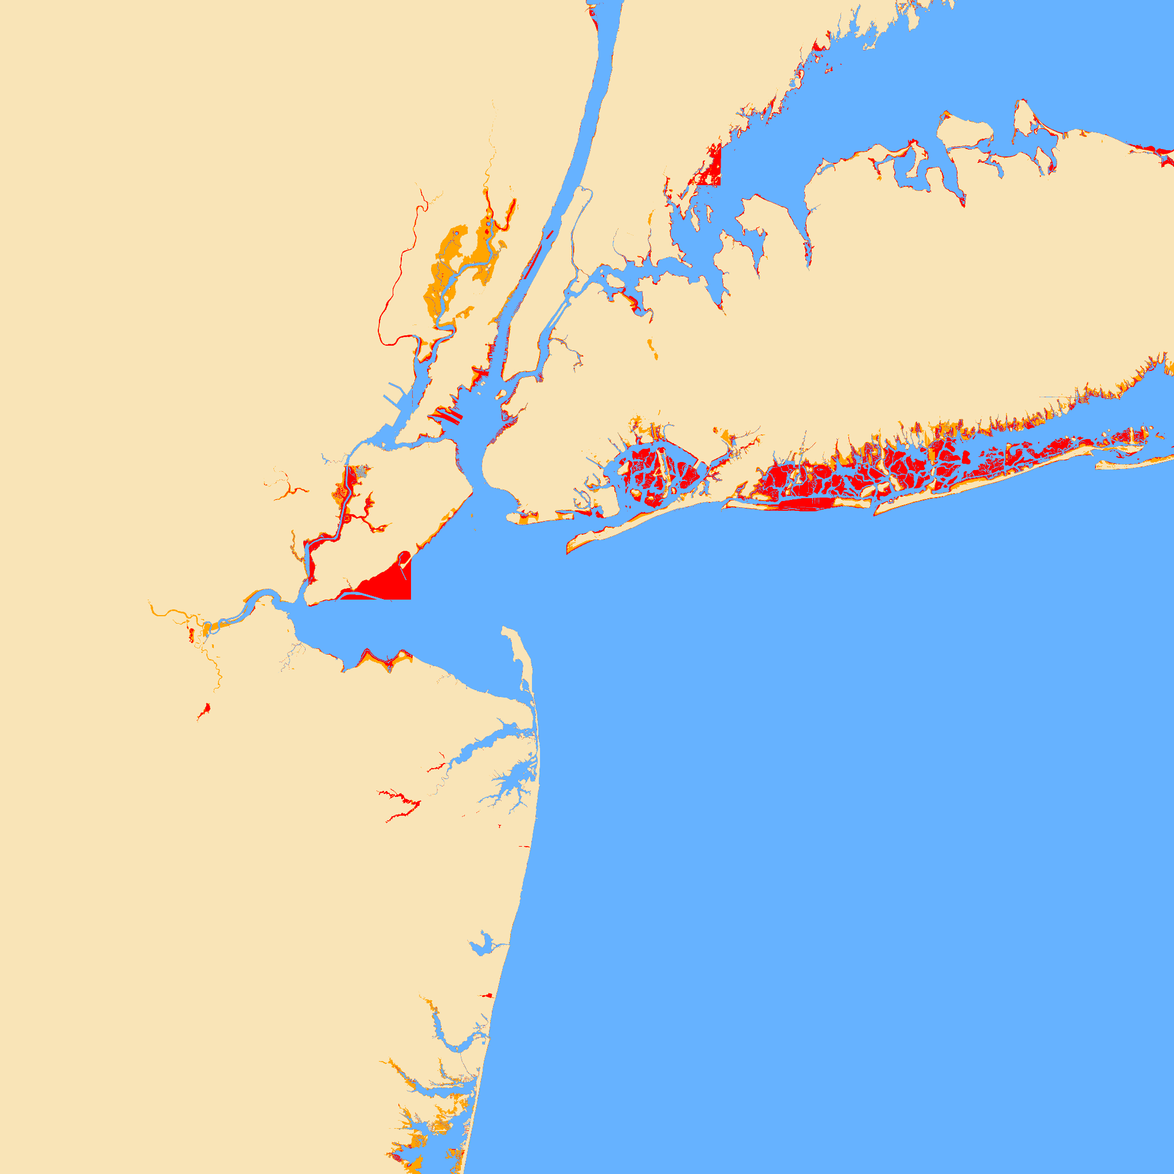
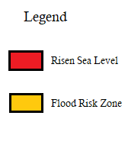
New York

Slide 10
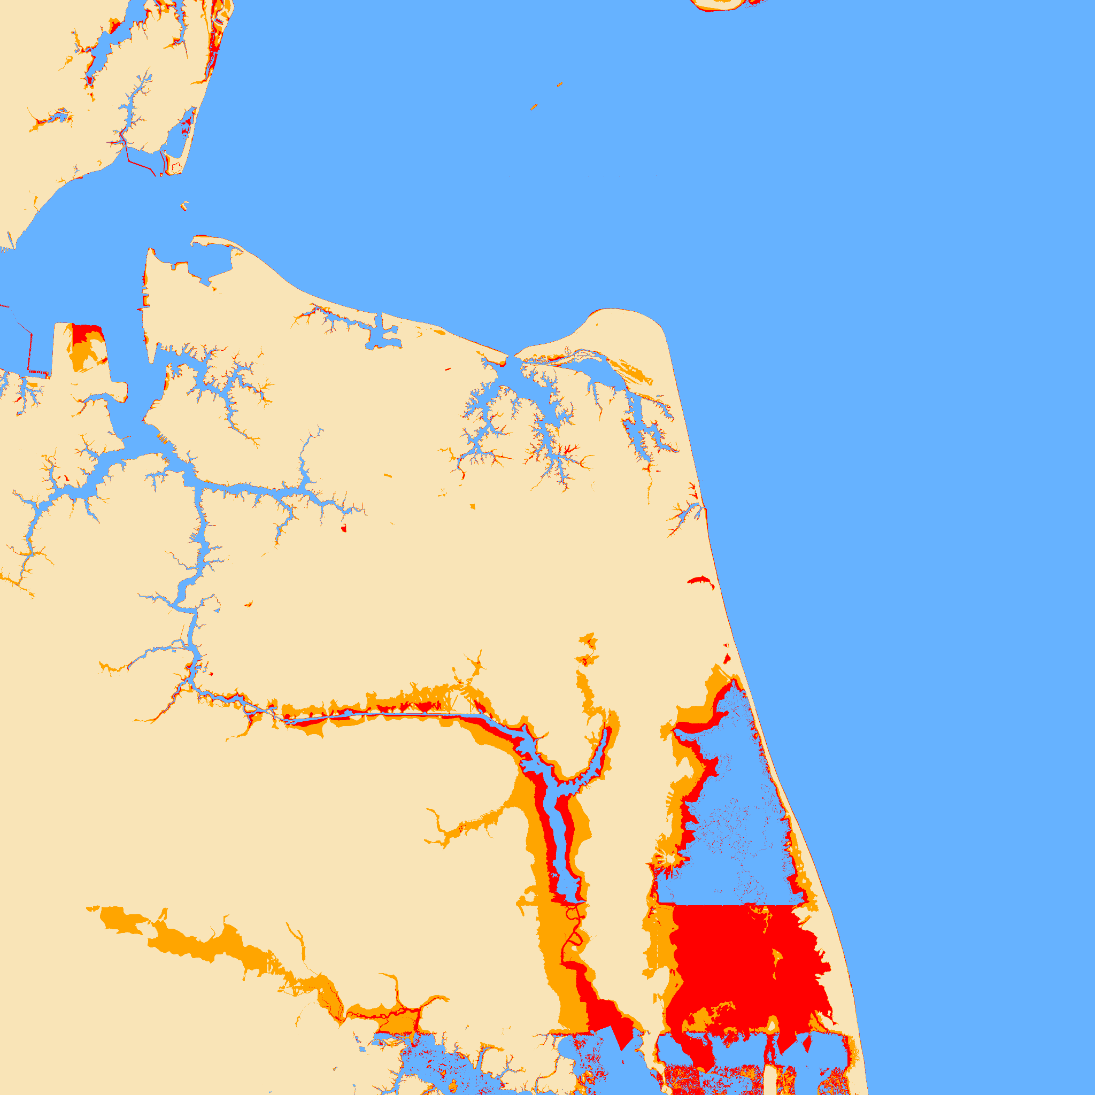
Virginia Beach

Slide 11
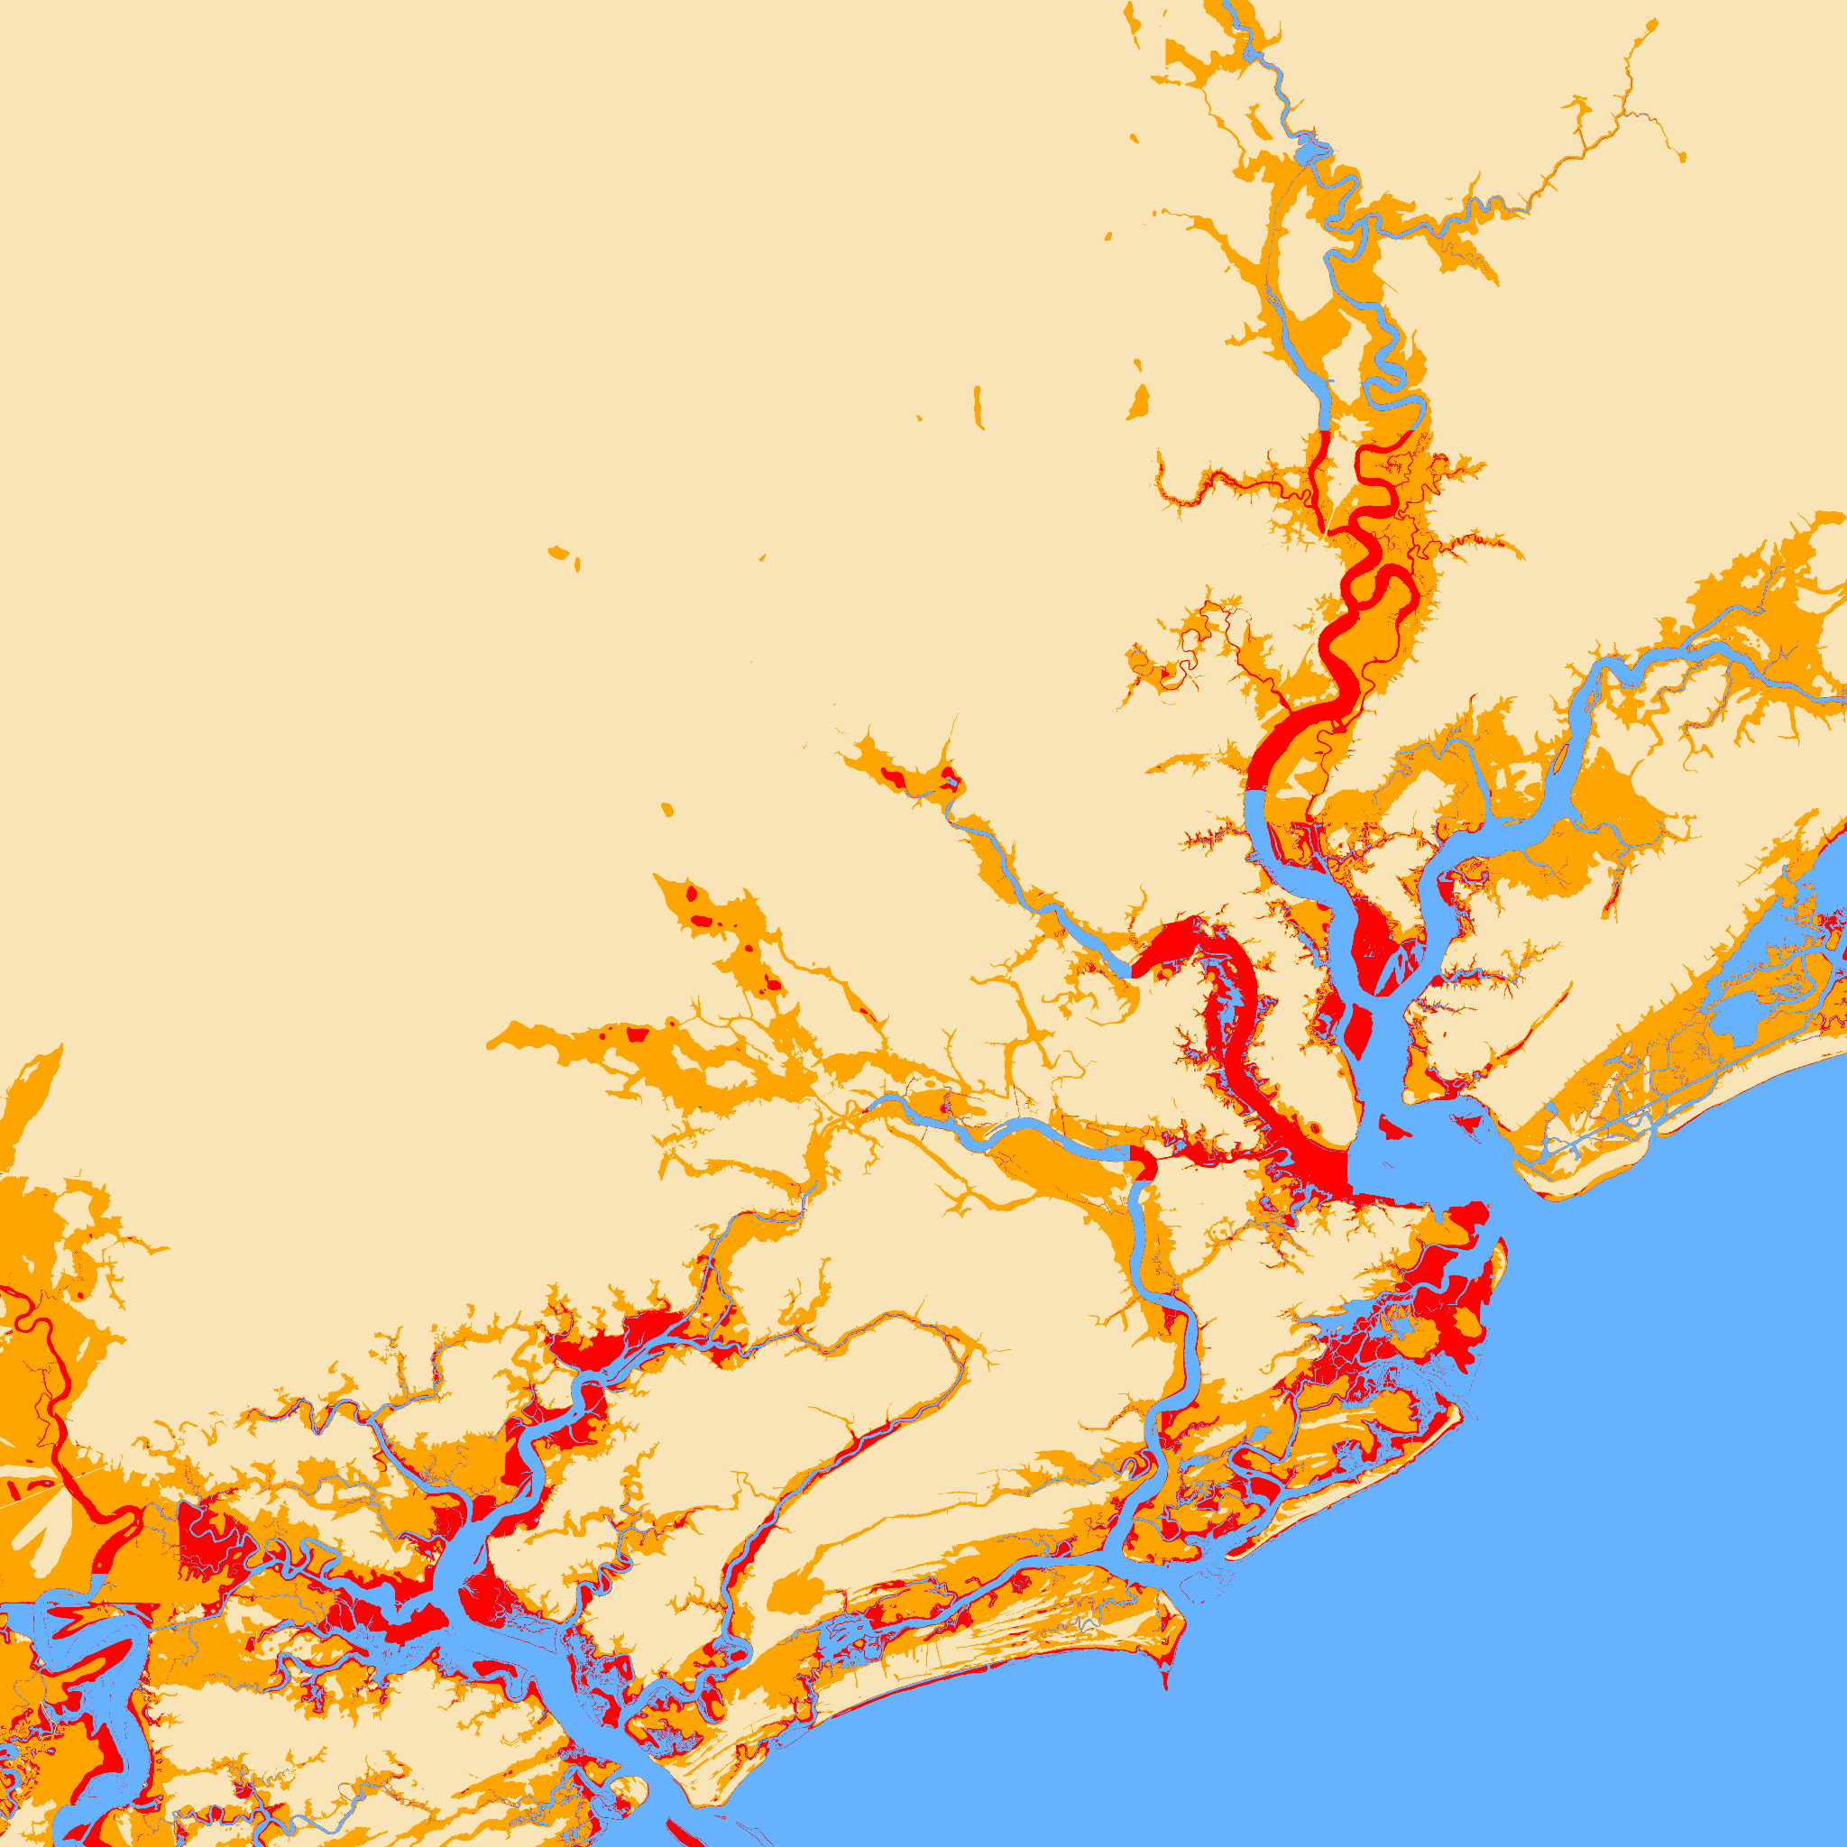
Charleston

Slide 12
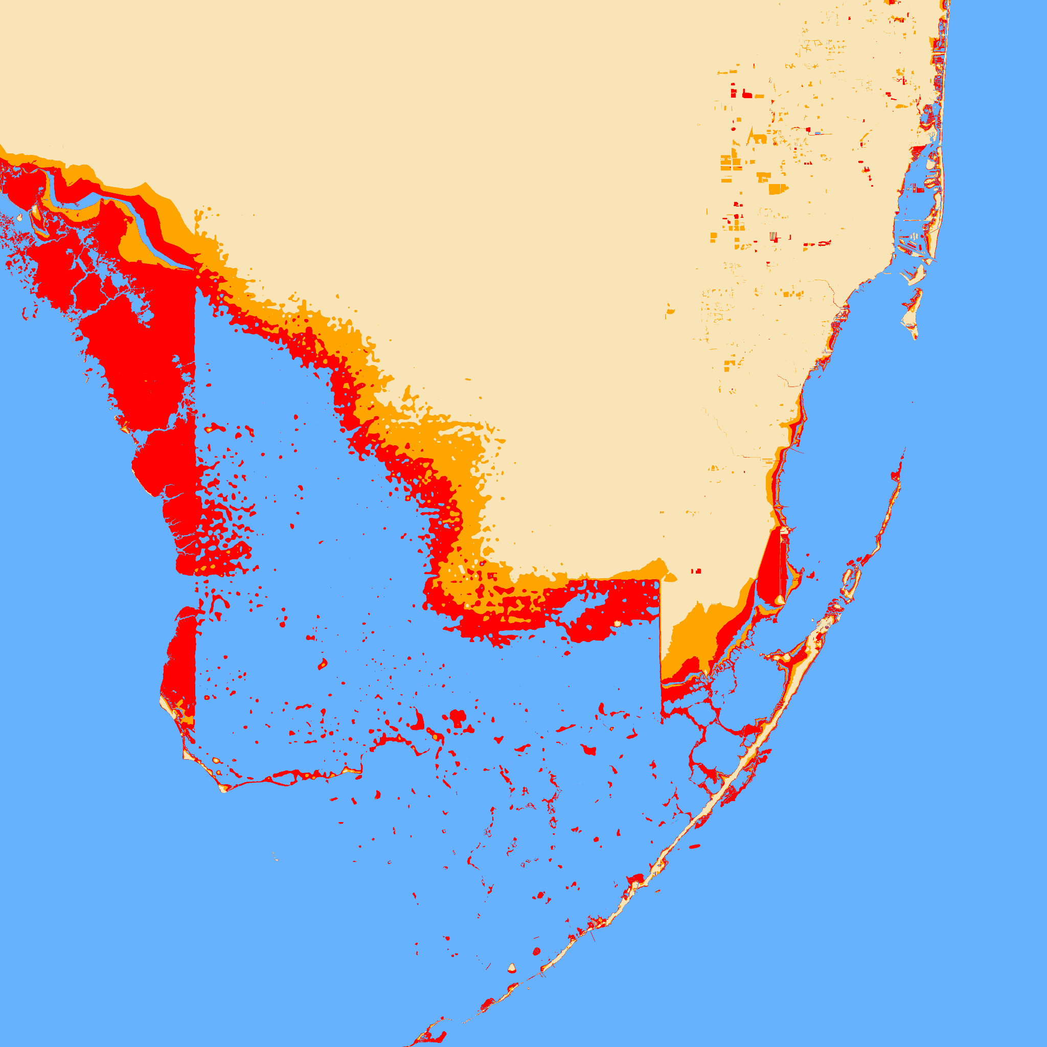
Southern Florida
Notes:
West Palm Beach, Ft. Lauderdale, Miami, Fort Myers (west)

Slide 13
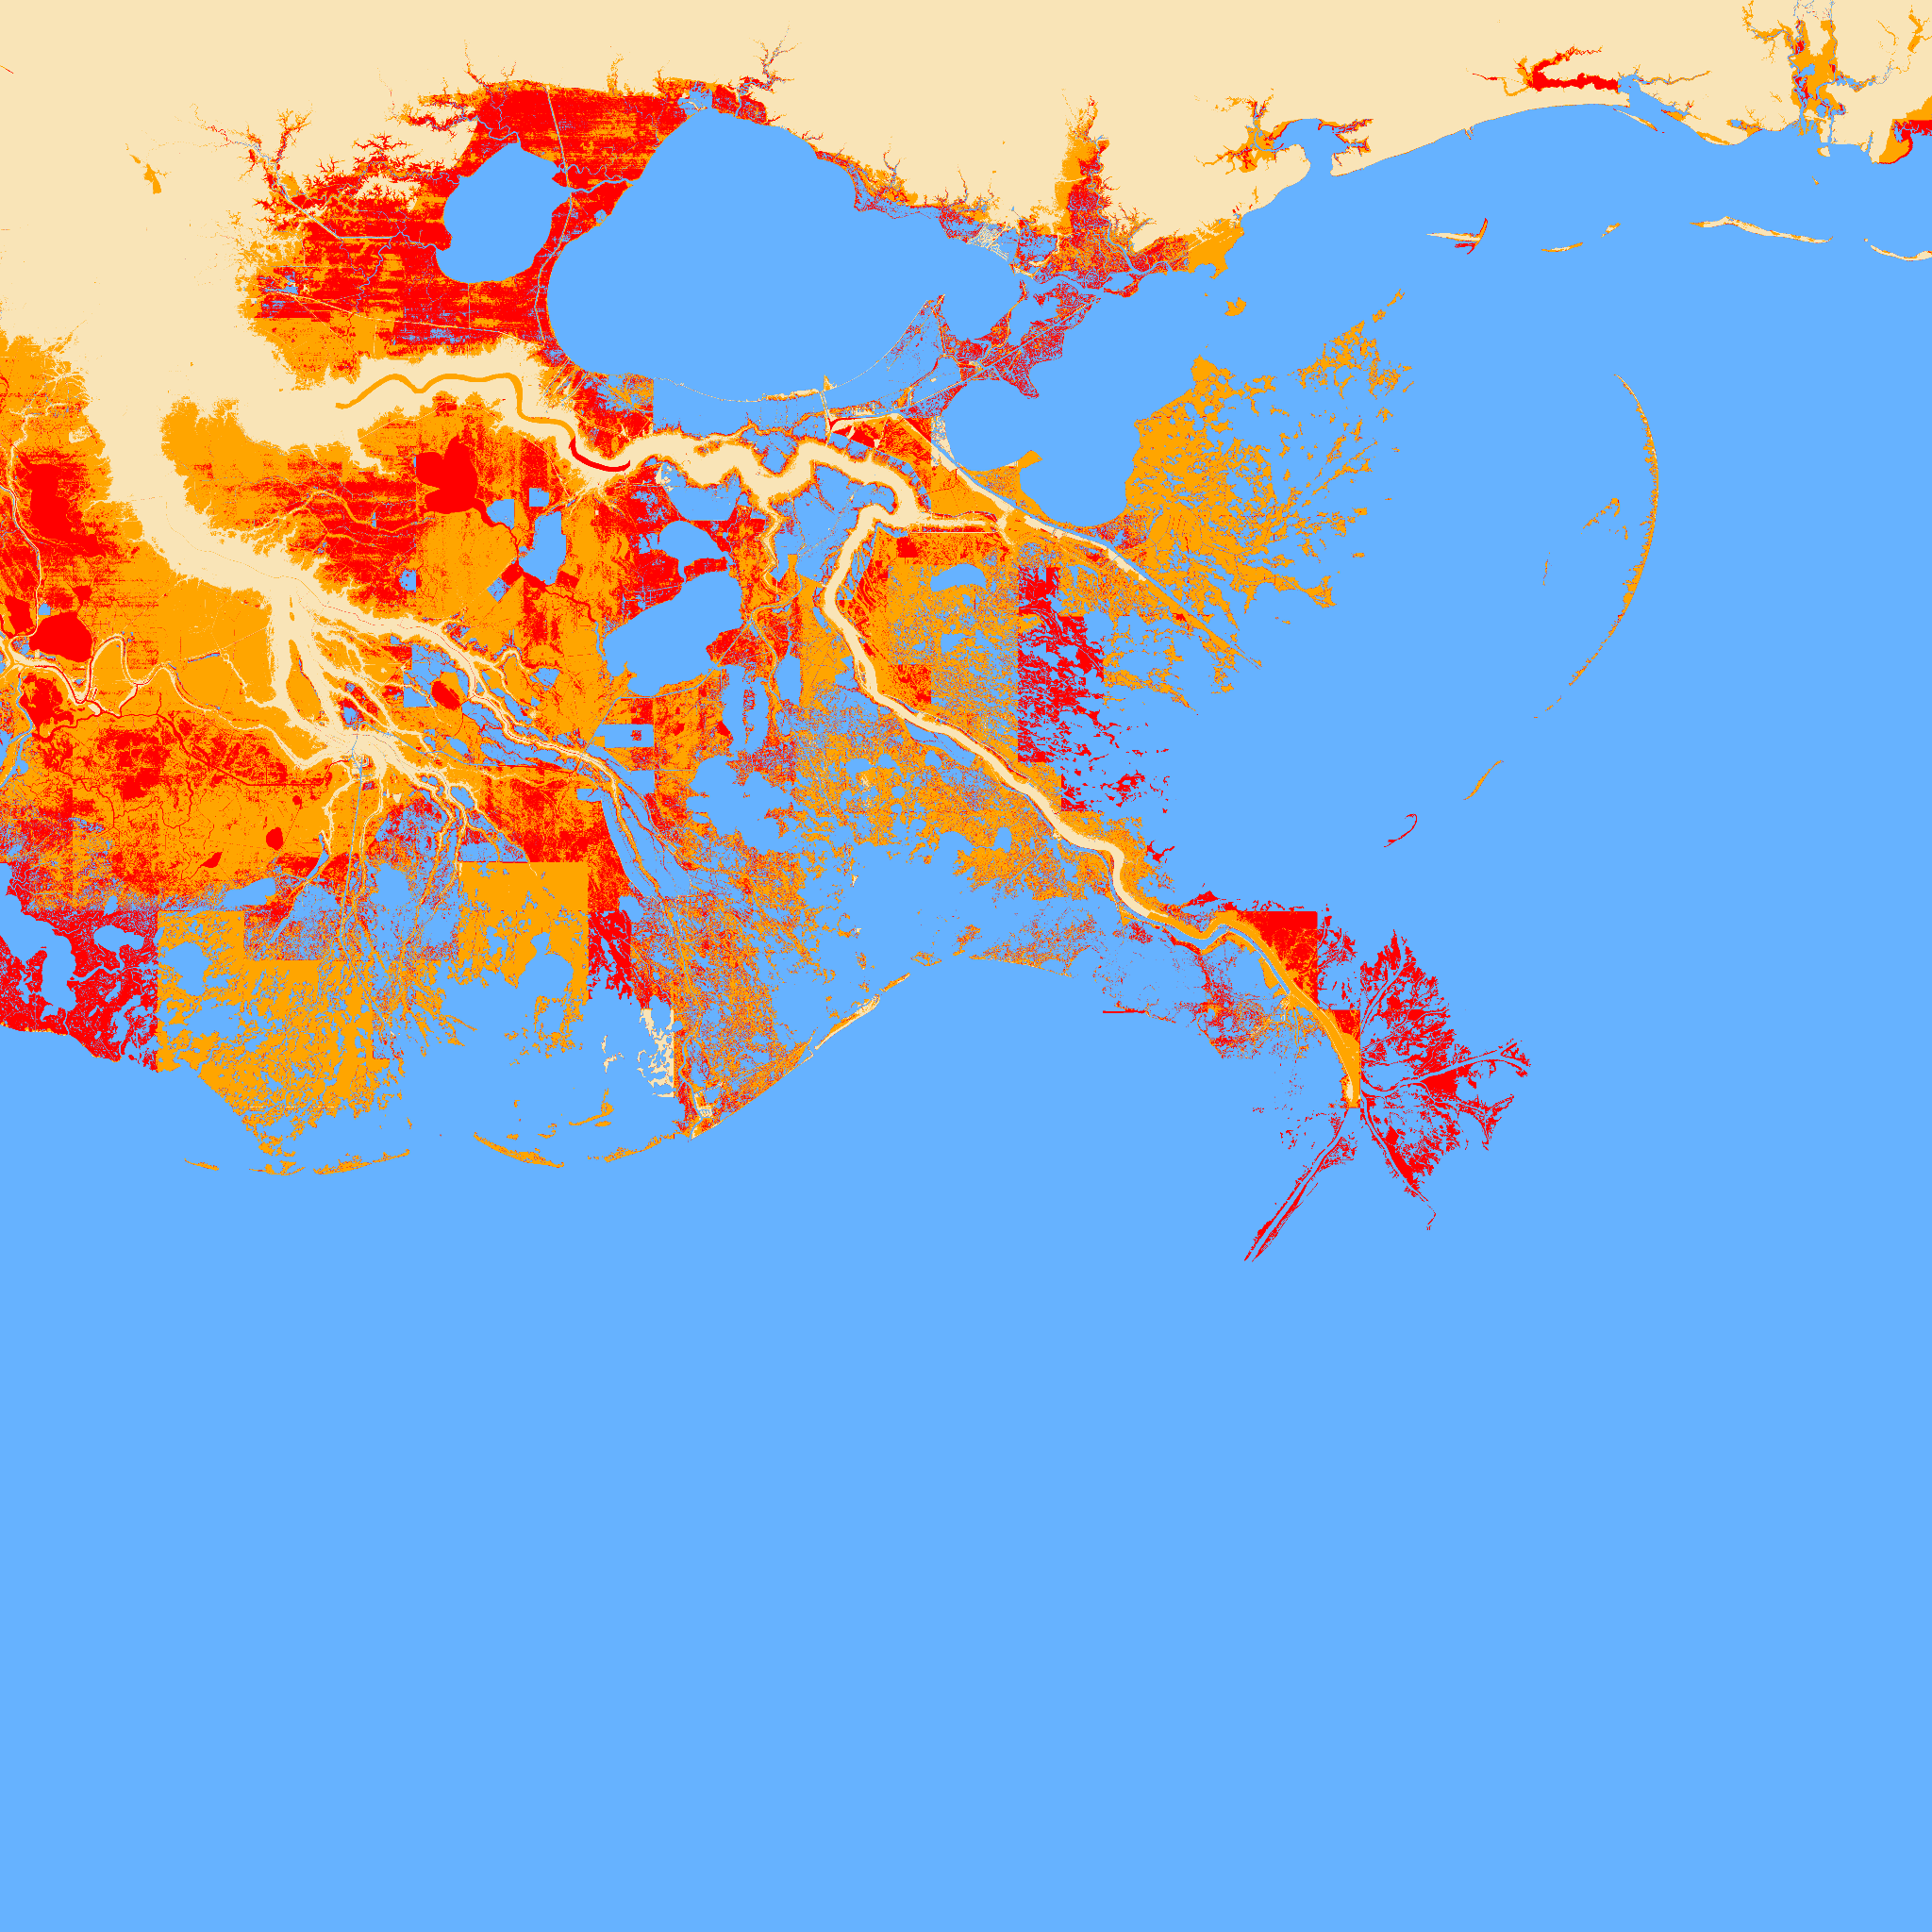
New Orleans

Slide 14
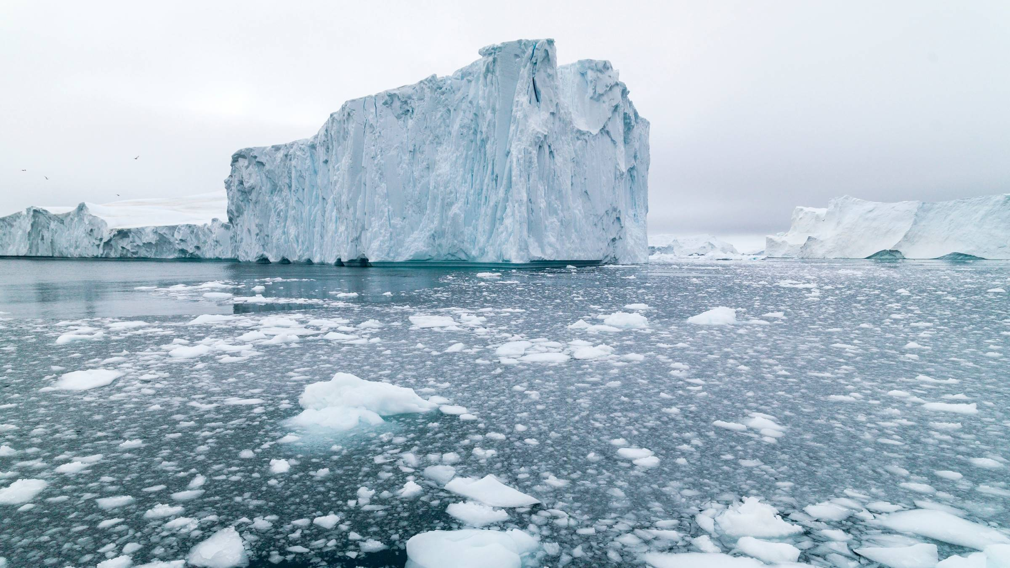
World impact
Human Impact
87% of the world population lives in the northern hemisphere
40% of the world population live within 63 miles of a coast.
Sea Impact
Changing water flow
Shrinking fish
Increased parasite population
Notes:
Richard explains the world impact.

Slide 15
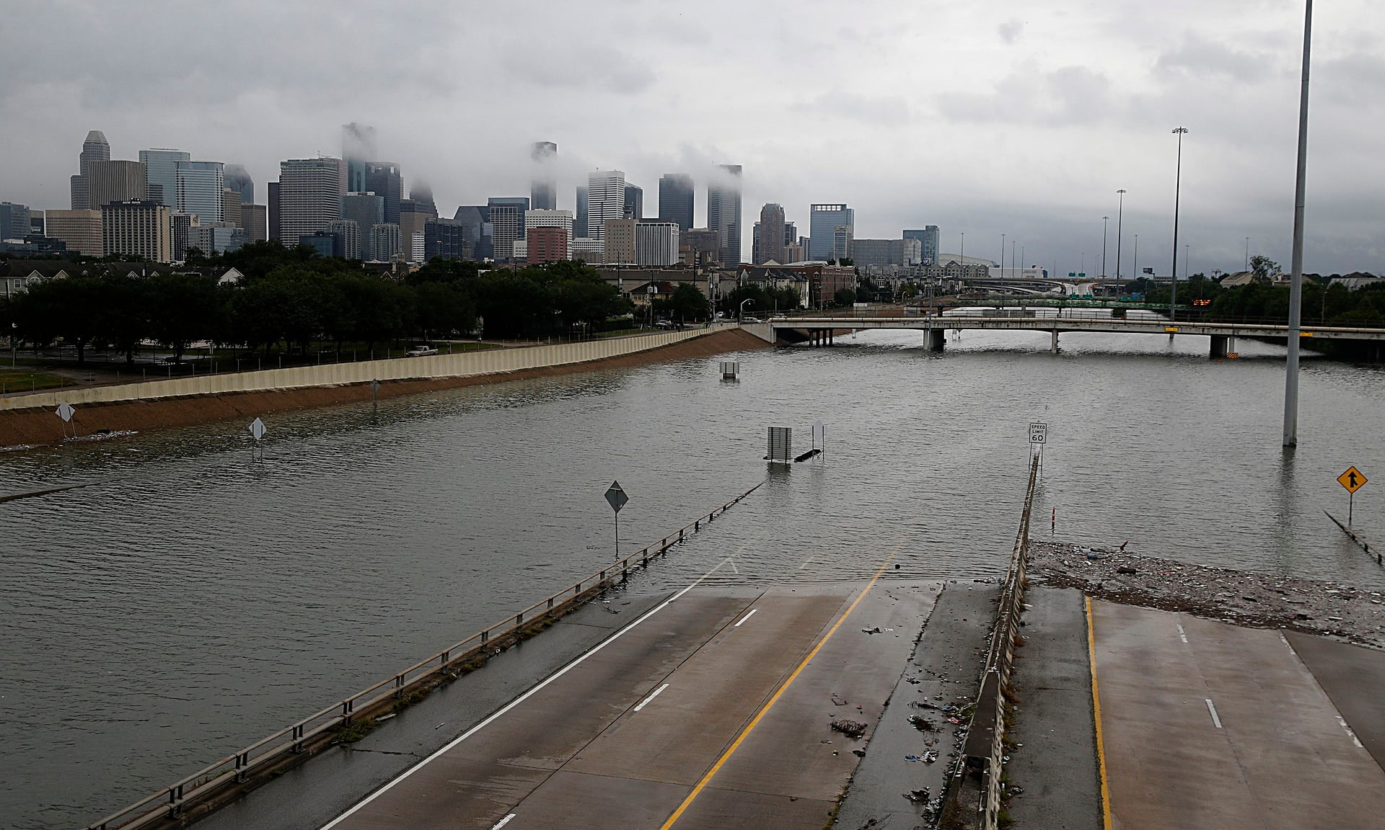
Summary
Sea ice is melting at an increasing rate
Sea level is rising rapidly as sea ice melts
Many coastal cities will be in danger if the trend continues
Notes:
Richard summarizes our project and fields any questions if necessary.

